Slide 1
NETRASAGAR APP
App for Fisheries personel

Slide 2
SUMMARY
This app has following key features
Issue fishing pass and Close pass on arrival of vessel
Enter fish catch for each vessel
View summary reports
Add, Edit, View Crew details
View vessel details
Fish Licence renewal
Approval of fishing pass applied from DOF PASS app

Slide 3
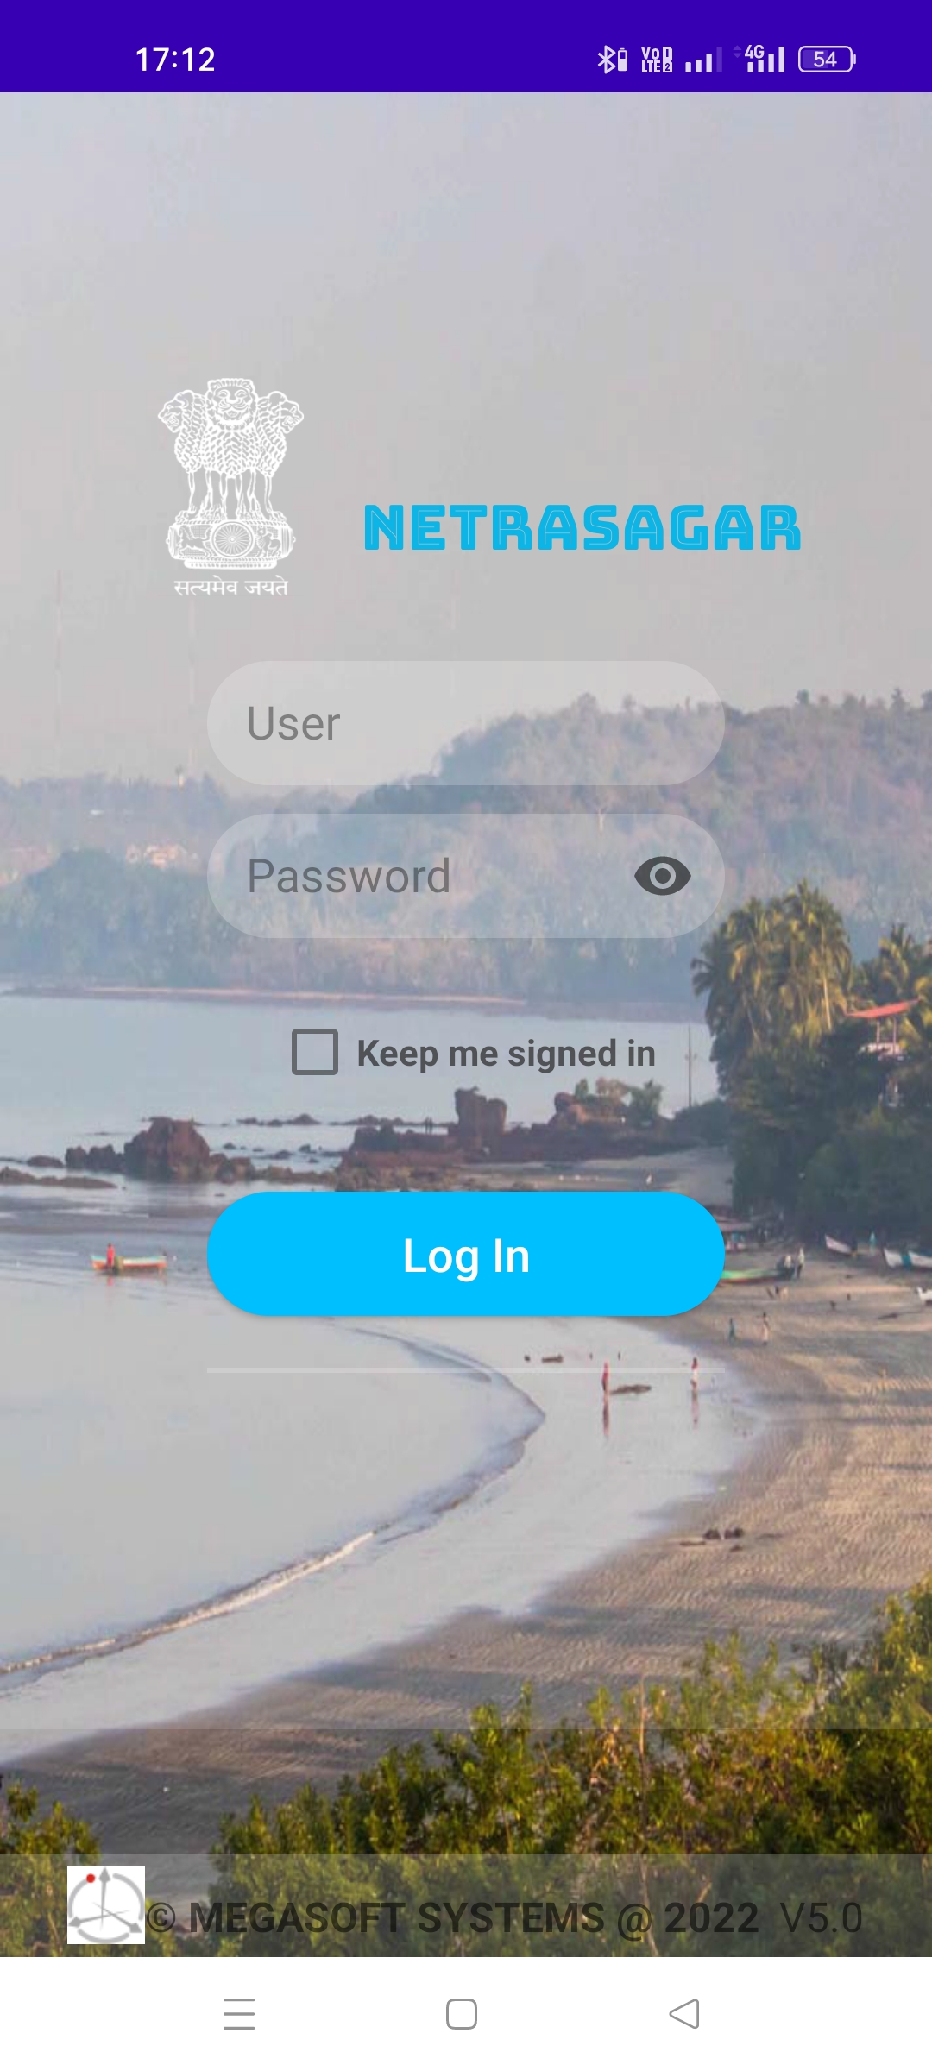
LOGIN Login into app
Login credentials
Select to sign in automatically when app is opened
Login into App
App Version

Slide 4
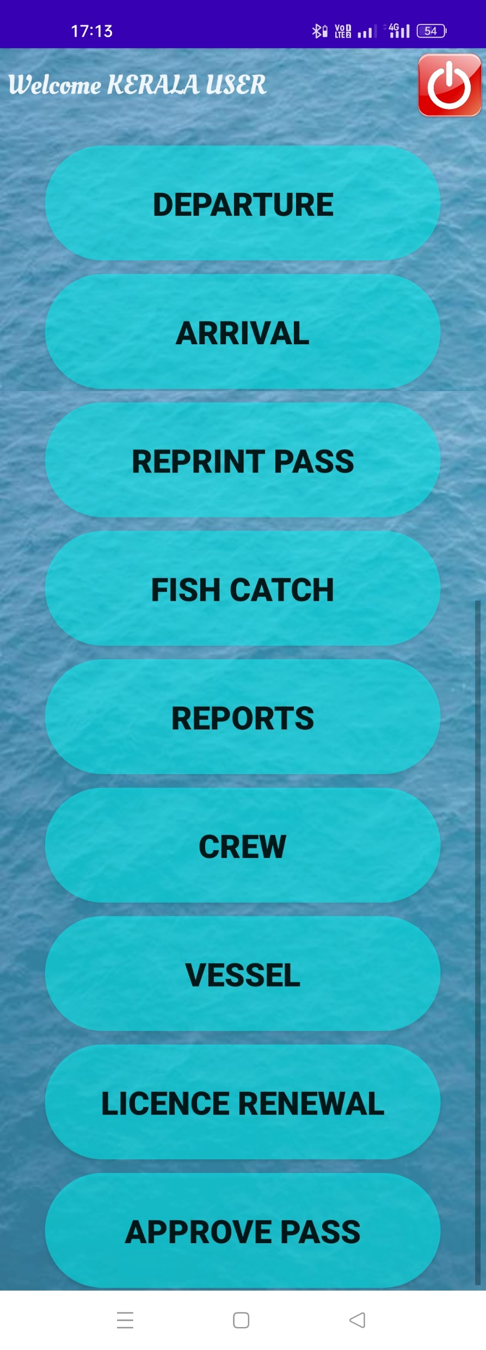
OPTIONS Select option like to issue fish pass, reports, fishing licence, etc.
DEPARTURE – To issue fish pass toa vessel when it is going in sea for voyage.
ARRIVAL – To close fish pass once vessel is returned from voyage.
REPRINT PASS – Reprint Pass issued (works only on POS terminal)
FISH CATCH – Add fish catch of each vessel
REPORTS – View different summary reports
CREW – View, Add, Edit crew details.
VESSEL – View vessel details
LICENCE RENEWAL – Renew fishing licence.
APPROVE PASS – Approve pass issued by DOF PASS app

Slide 5
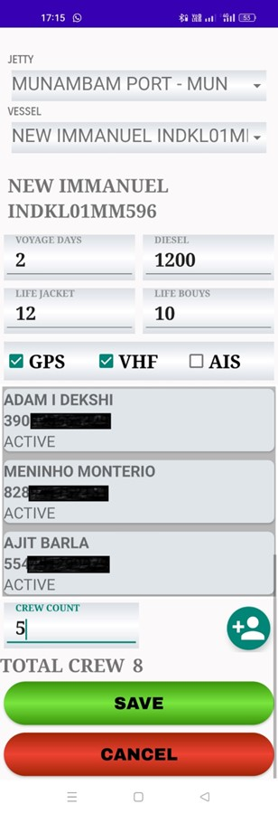
DEPARTURE Open fish pass
Select PORT / JETTY
Vessel name & VRC
Select Vessel
Voyage days
Diesel in Liters
Life Jackets
Life Bouys on Vessel
GPS, VHF, AIS present
Crew going for Voyage
Additional Crew
Add Crew
Total Crew
OPEN Fishing Pass

Slide 6
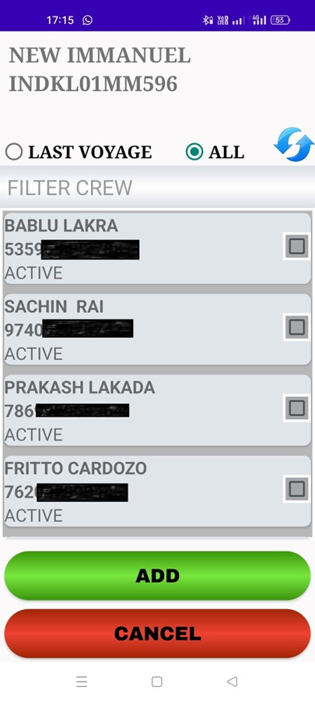
DEPARTURE – ADD CREW Add crew to fish pass
All registered Crew list
Crew List From Last Voyage
Reload Crew List
Search Name or Aadhar No.
Select Crew to add
Add Crew

Slide 7
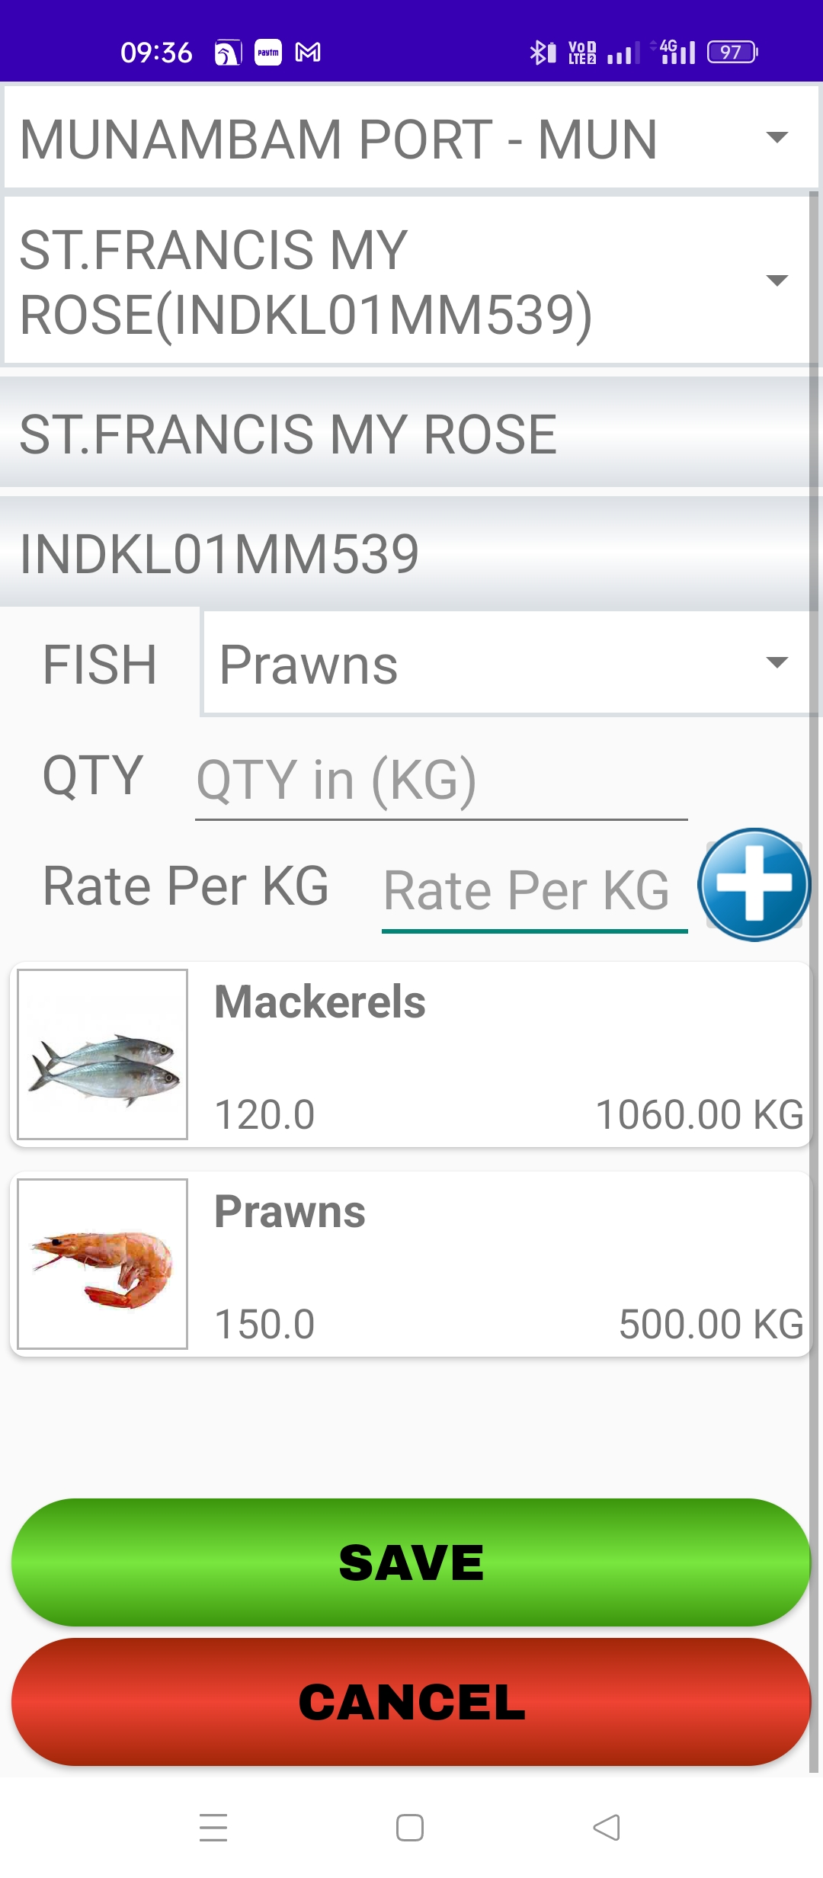
ARRIVAL Fish pass closing with fish catch.
Select Port / Jetty
Select Vessel
Vessel Name and VRC
Select Fish
EnterFish Qty in KG
Add Fish catch details
Enter Rate per KG
Added Fish catch details. Long tap to delete
SAVE Fish catch data

Slide 8
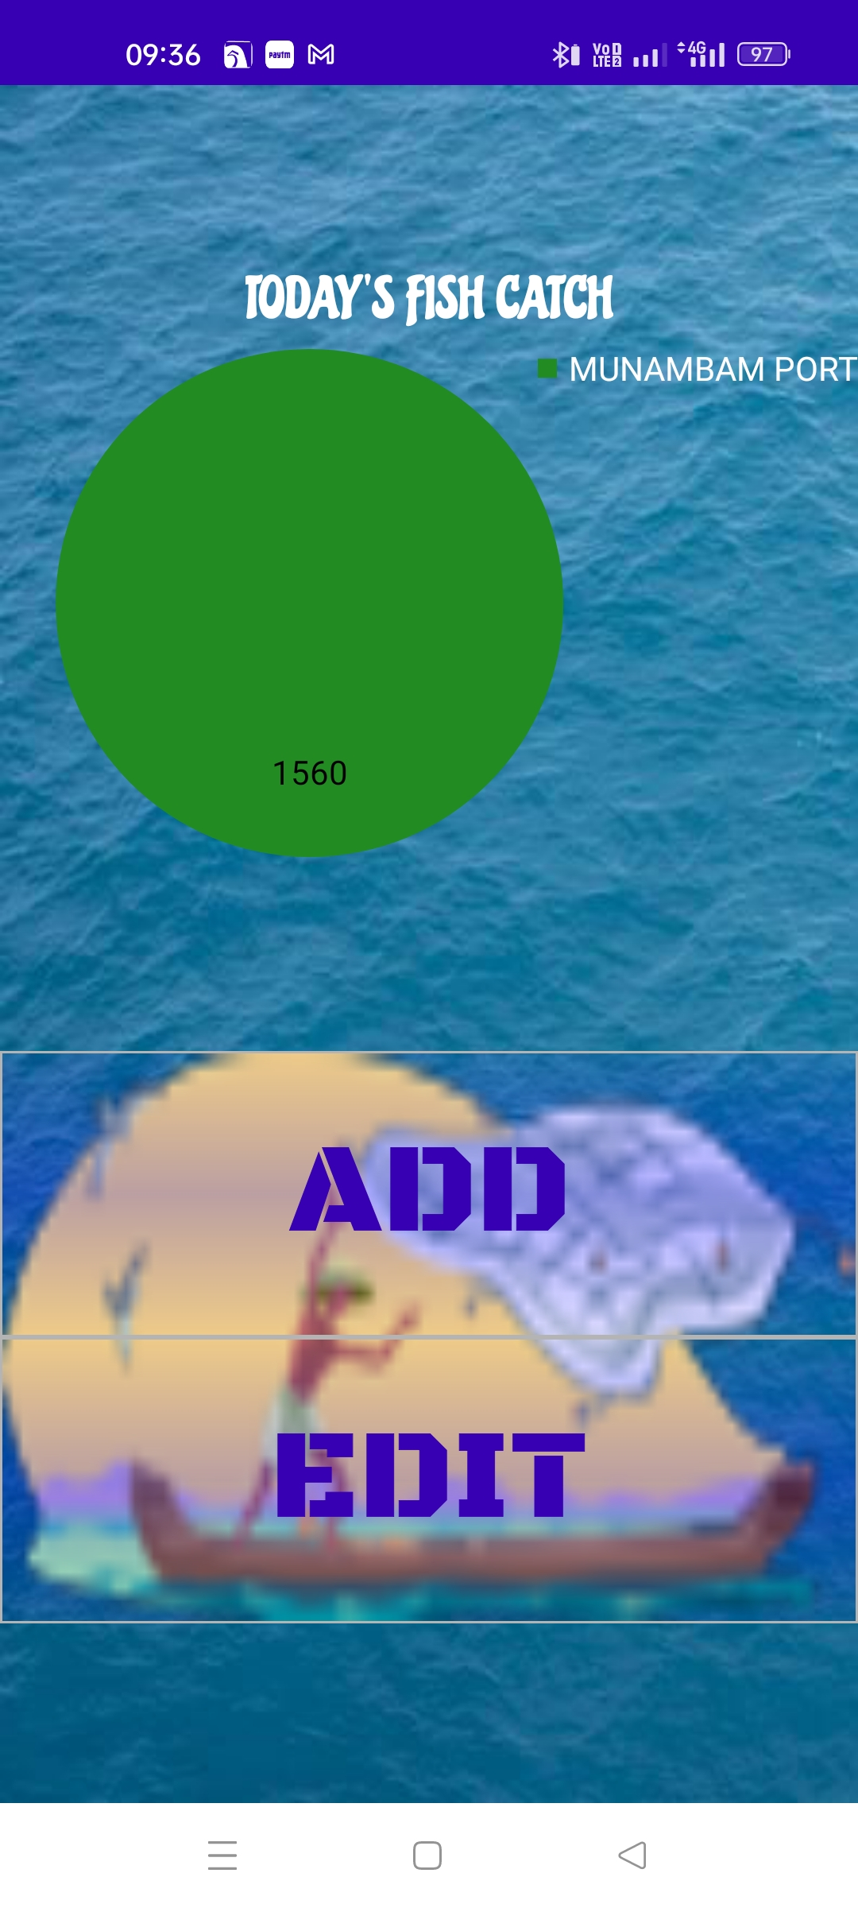
FISH CATCH Add edit todays fish catch
Add Fish Catch
Edit todays Fish catch

Slide 9
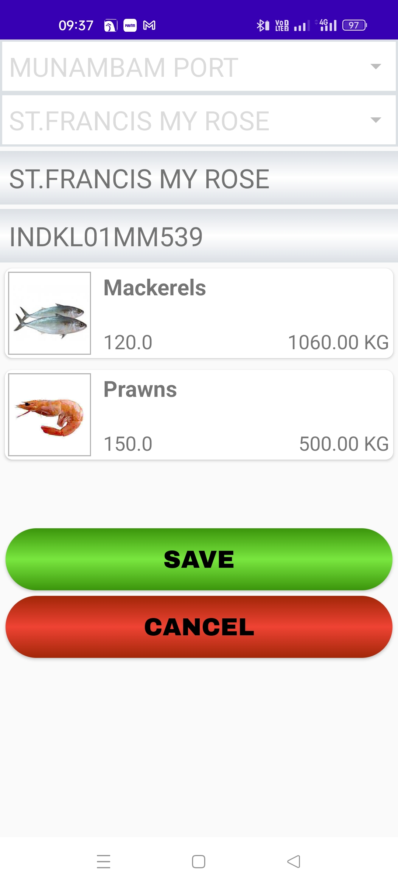
FISH CATCH Add edit todays fish catch
Select PORT / JETTY
Select Vessel
Select Fish
Tap to edit Qty
EnterFish Qty in KG
Enter Rate per KG
Add Fish catch details
SAVE Changes
Long tap to delete
SAVE Changes
Add Fish Catch Data
Edit Fish Catch Data

Slide 10
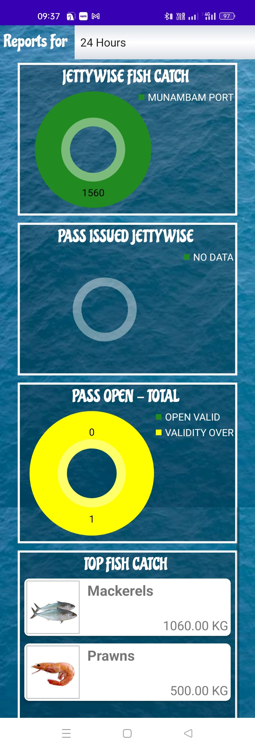
REPORTS Summary of fish pass issued and fish catch
Select time period
Reports for selected period

Slide 11
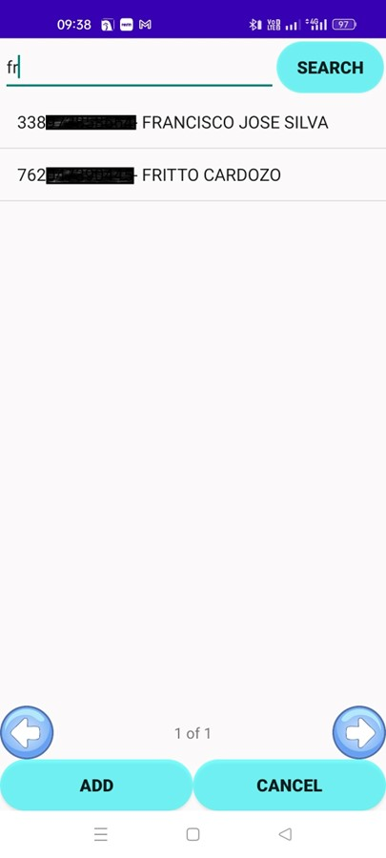
CREW List of crew in Netrasagar
Display List
Search with Name or Addhar No
Select to view / Edit crew details
Previous Page
Next Page
Add New Crew

Slide 12
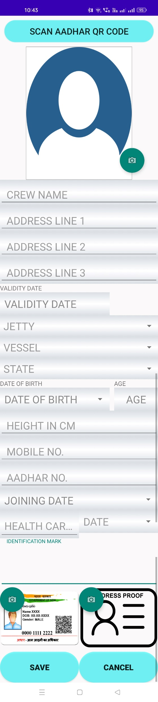
CREW - ADD Add new crew to Netrasagar
Scan Aadhar Card to get persons details
View Photo
CREW NAME – Name of person
ADDRESS – 3 lines of persons residential address
VALIDTY DATE – It gets automatically updated to end of fishing season i.e. 31st May
JETTY – Select JETTY / PORT
VESSEL – Select Vessel on which person will be employed
STATE – Persons residential State
DATE OF BIRTH – persons Date of Birth
AGE – Automatically calculated depending on Date of Birth
HEIGHT IN CM – Enter height of person in centimeters
MOBILE NO. – Mobile number of person
AADHAR NO. – Aadhar card number of person
JOINING DATE – Date when person joined for work on vessel
HEALTH CARD NO. – Health card number
DATE – Health card issue date
IDENTIFICATION MARK – Any identification mark on persons body.
Capture Photo
Capture Aadhar & Address Proof
SAVE CREW DETAILS

Slide 13
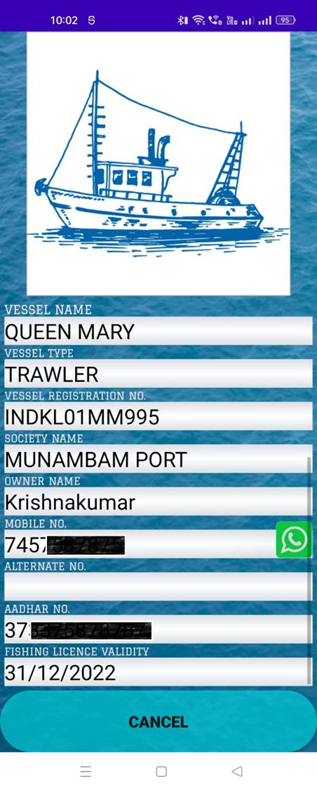
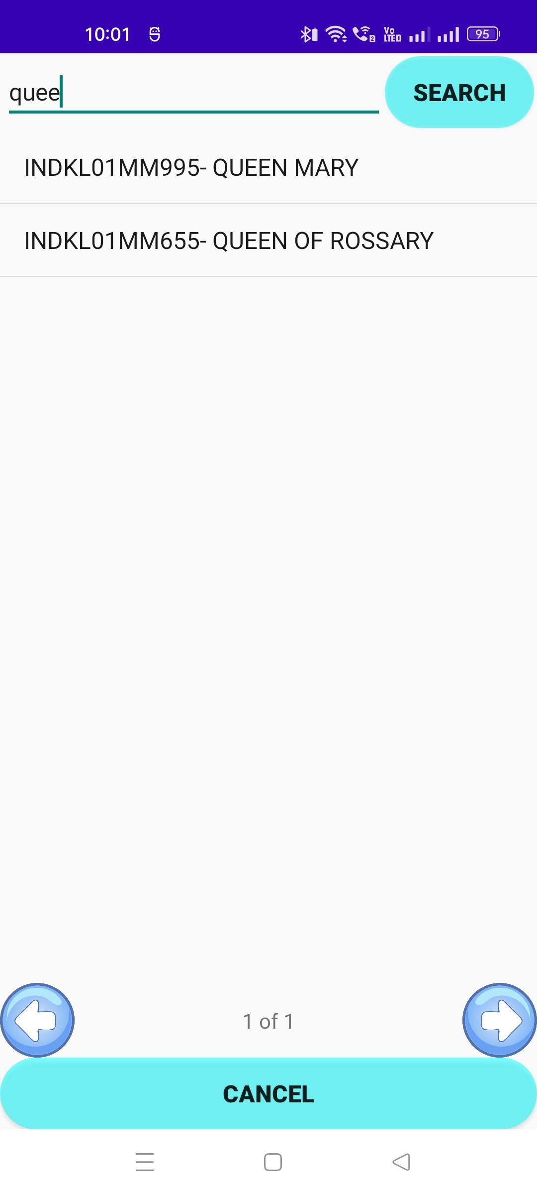
VESSEL Login
Display List
Search with Name or VRC No
Select to view vessel details
Next Page
Previous Page
VESSEL DETAILS

Slide 14
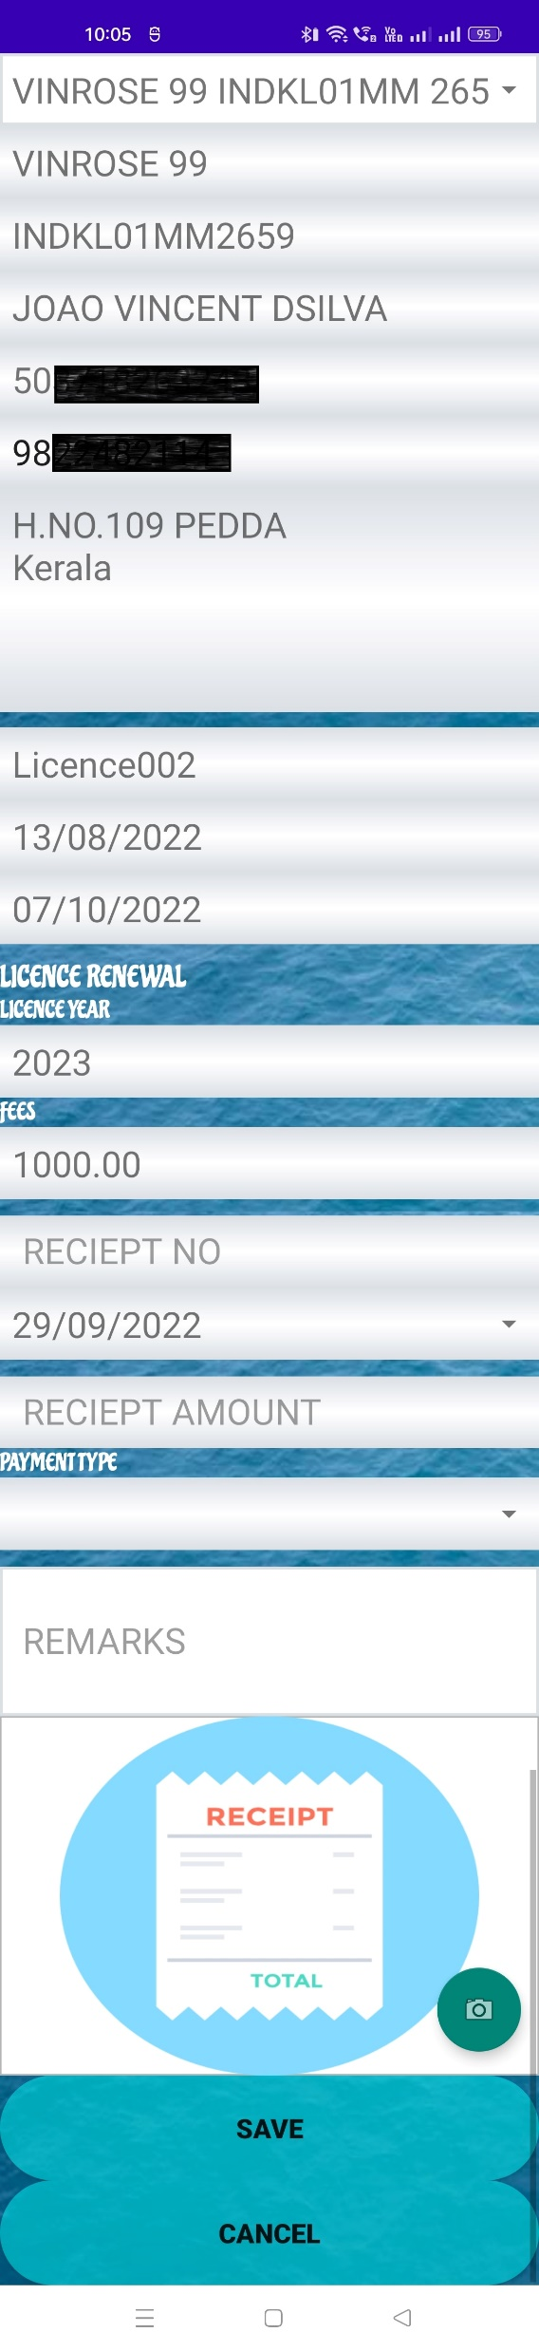
FISHING LICENCE Renewal of fishing Licence
Select Vessel
Enter Reciept No.
Enter Reciept Date
Enter Reciept Amount
Enter Payment Type
Update renewal of fishing licence.
Upload Photo of receipt.

Slide 15
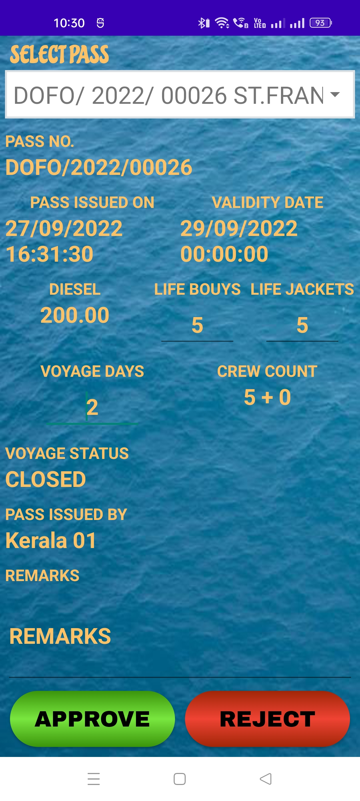
FISHING PASS APPROVAL Approval of fishing pass
Select Pass to approve
Approve fishing pass

